Slide 2
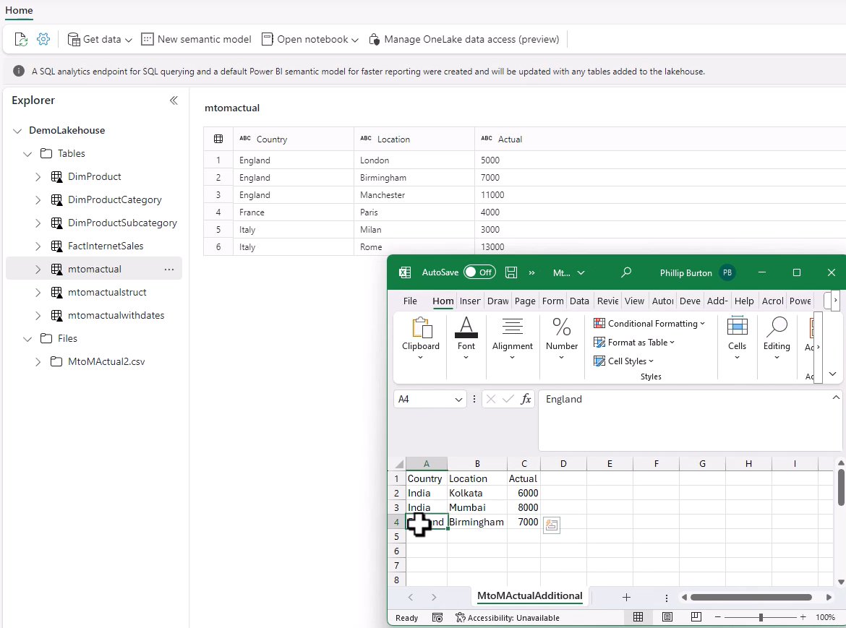
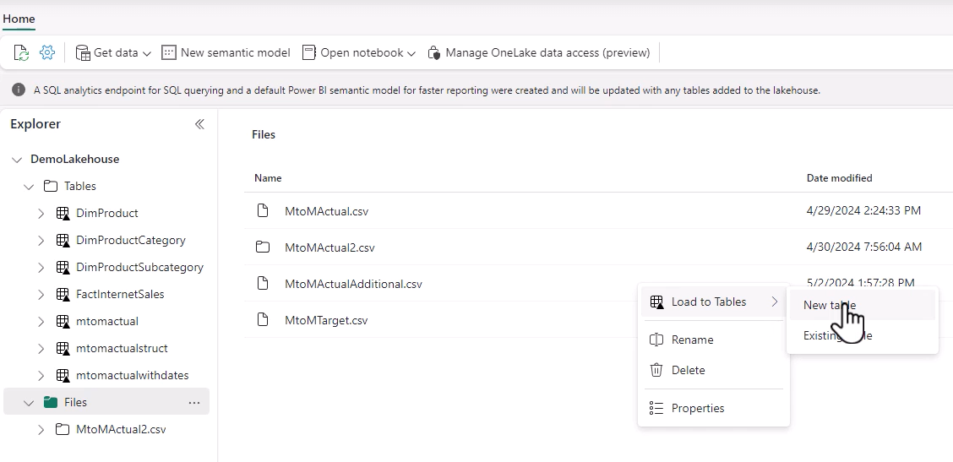
60. Merging Data
Notes:
How we going to merge this data.
We first import that file
Wew now convert thye file to a trable
This was the additional table

Slide 3
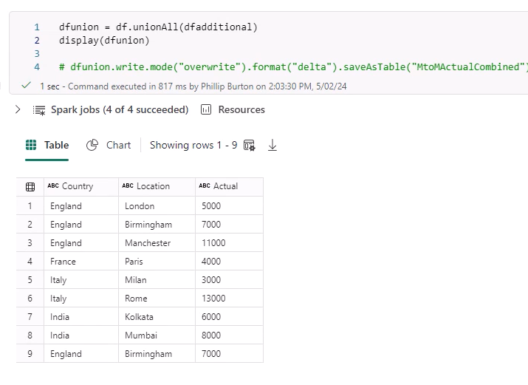
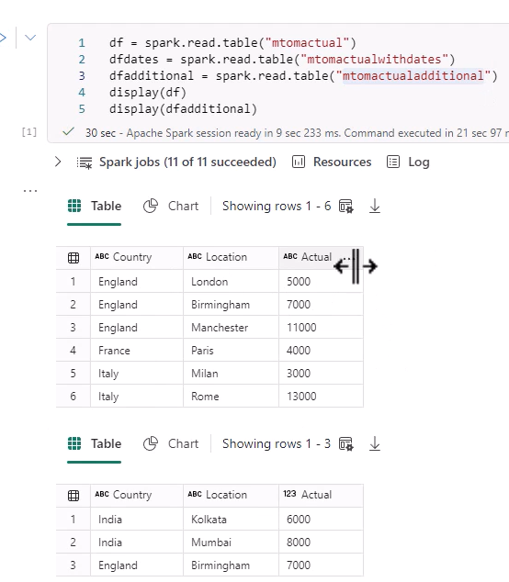
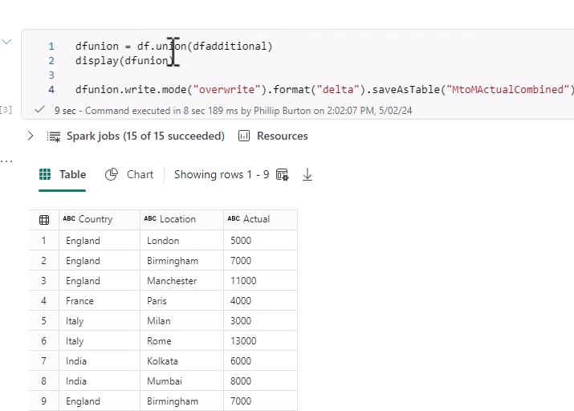
Now we load the 2 tables
Notes:
We want to mkerge the dfs
We use union (similar to append) , we also save it
U can also use unionAll.

Slide 4

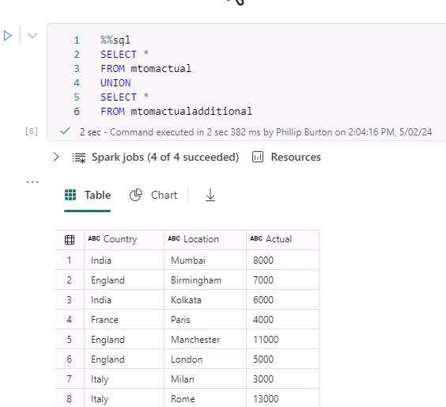
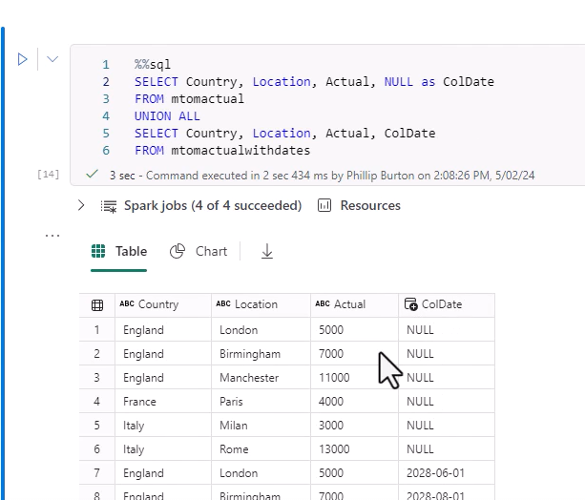
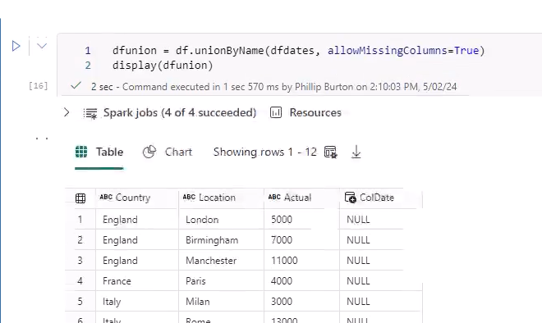
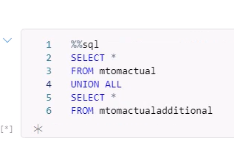
SQL Merge
Notes:
Note 8 rows , not 9 rows
NB. Union in SQL removes duplicates
Union and unionall does not remove duplicates
If you want all rows in sql use unionall.
NB> In sql tye columns need not be idenbtically names for union to take place.
Now we try union where one of tables has extra column. It errors out , see error on the top right.
We add a column of nulls to the table with less columns and it works in SQL.
In pyspark it also does not work. Same error
But here we can use unionByuName .. To get round the problem of different columns, with allowMissingColumns = True as a parameter. Works.

Slide 5
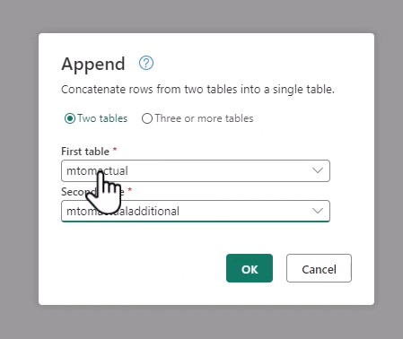
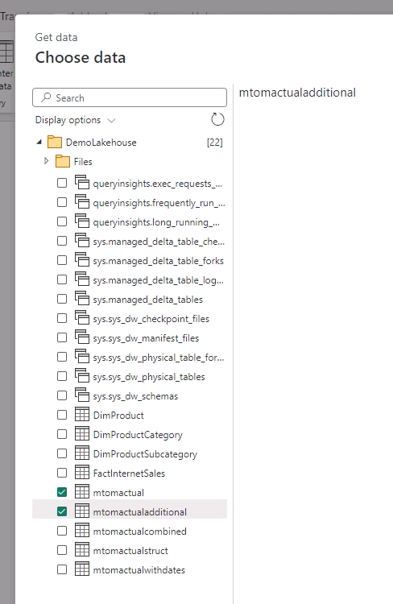
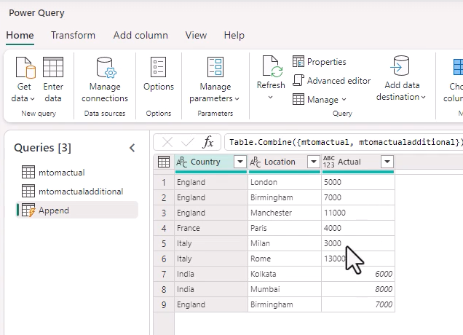
Merge By Using DataFlow Gen2.
Notes:
Choose data
Select L:akehouse and select the tables to bring into Dataflow.
Home Append Queries

Slide 6
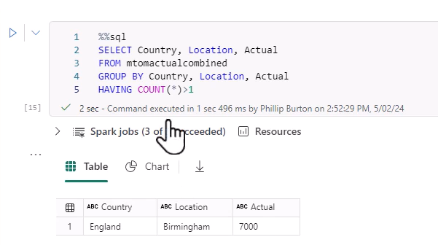
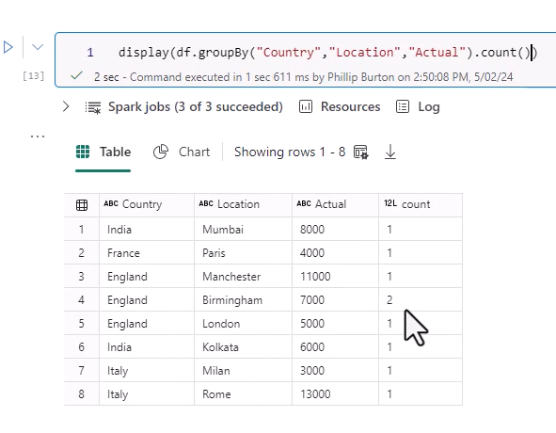
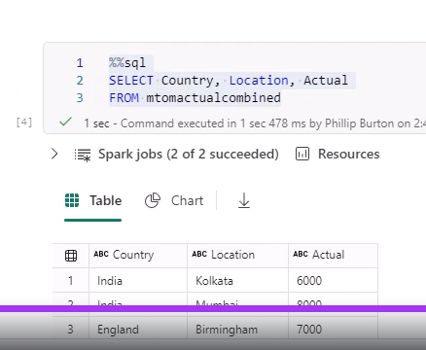
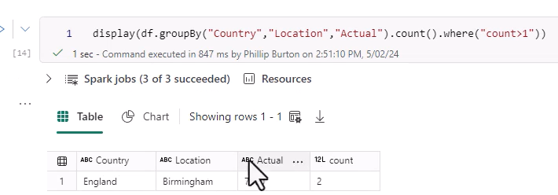
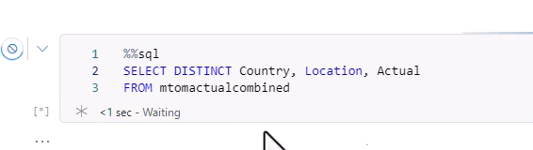
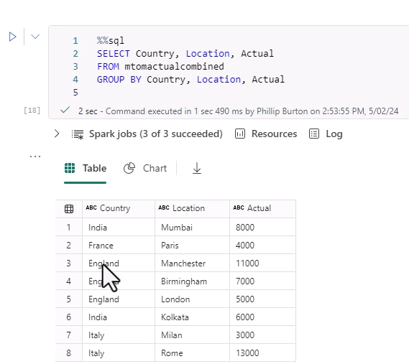
61. Identify and resolve duplicates
Notes:
We can find duplicates by counting them in a groupby of all the columns., see above. Spot the dupolicate.
To identify dulicates we say where count > 1 ; counjt is name of column.
And in SQL . Musty use having , and count(*) >1; NB We didn’t have it in the select clause , jusdt in having..spark is not the same!
How do we get rid of problem. ..use select distinct in Pyspark, same in SQL
Or just do a Group By , no aggregation .. Gets you distinct combinations.

Slide 7
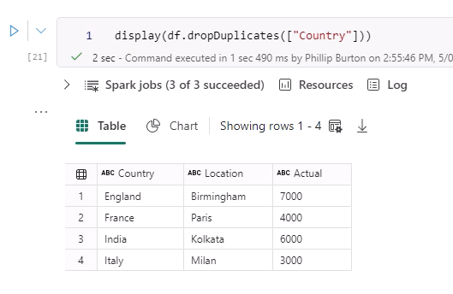
In Spark , you use dropduplicates , ande can mention columns in a list , brackets
Notes:
So if you list country , it will drop dupliocates in Country , ie keep
In dataflow genb 2 we can also drop duplicates

Slide 8
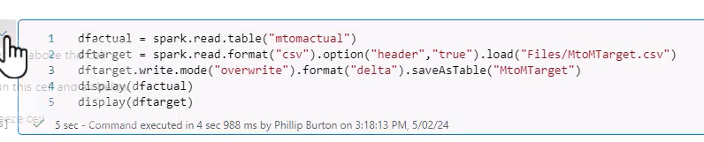
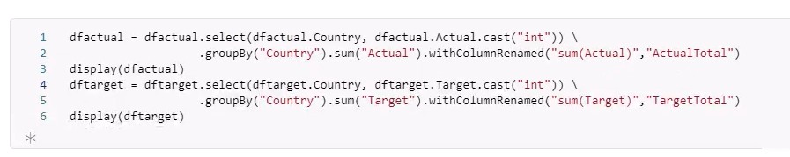
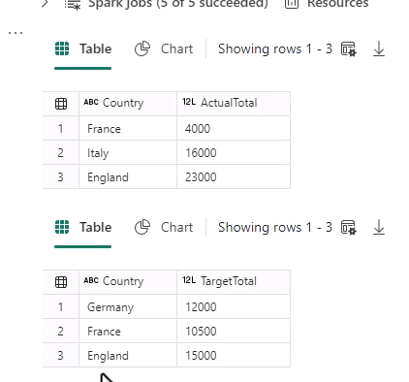
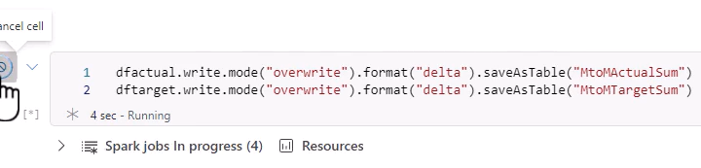
Joining Data Using Inner Joins.
Notes:
First read in the 2 datasets
Note thye casting of actual as int
Need to Groiup by and Rename of the first dataframe
We repeat with the Target
We save the tables

Slide 9
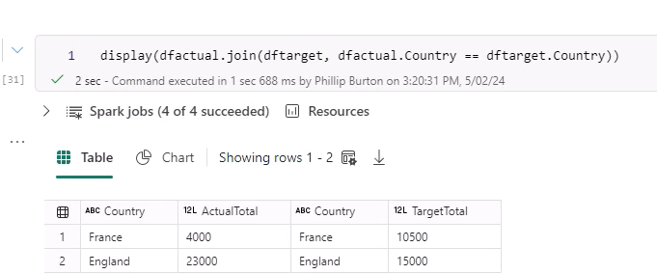
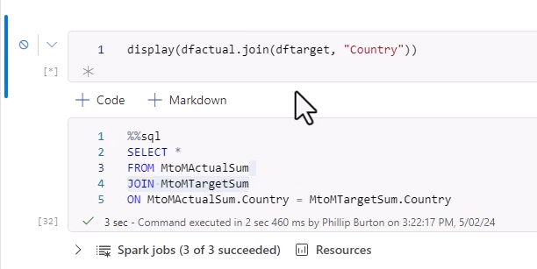
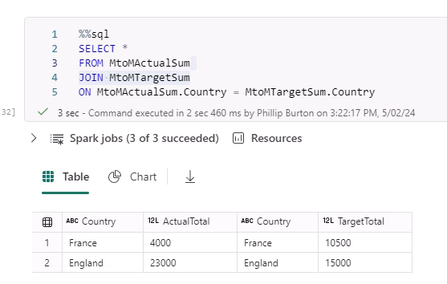
We now join by country
Notes:
Note thye 2 equal signs in the join statement, the above statement implies inner join (default)
See the SQL.
Because the namesare the same you could have country once.

Slide 10
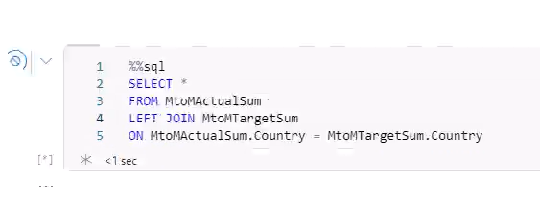
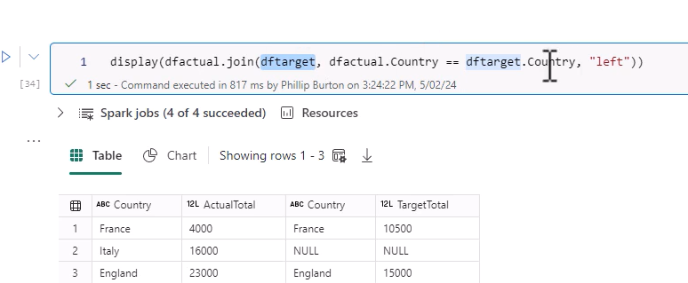
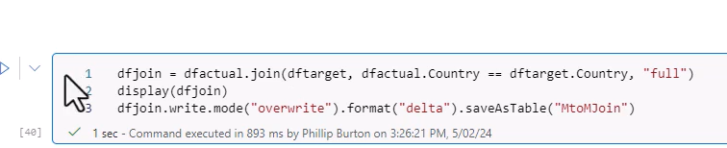
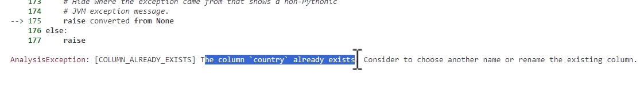
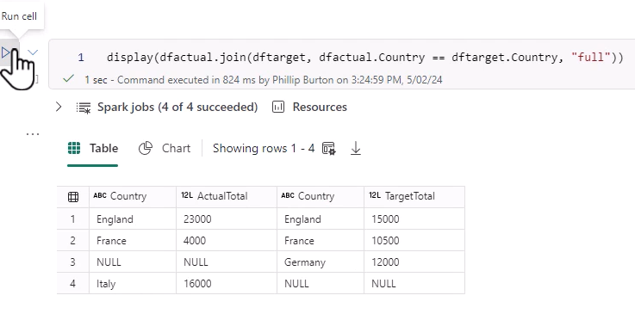
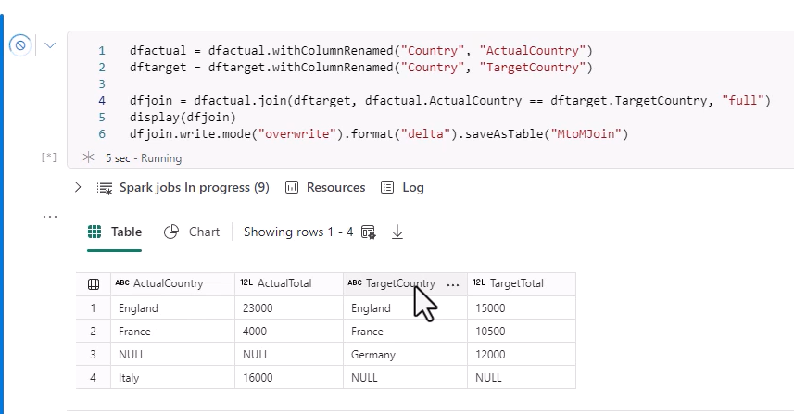
25. Other Joins
Notes:
We may want non overlapping rows in the result, hence use other joins
Se result for left join ..all rows left , note the position , last position says the join type , right in similar way
Full takes both , sql , left righ or full. , we save the full jpoin
The save gave an error., see rhs , the joins work but the saving does not, as col is duplicated.(Country)
We rename the country cols before the join , so then we have to specify joining columns , as they are not the same name!

Slide 11
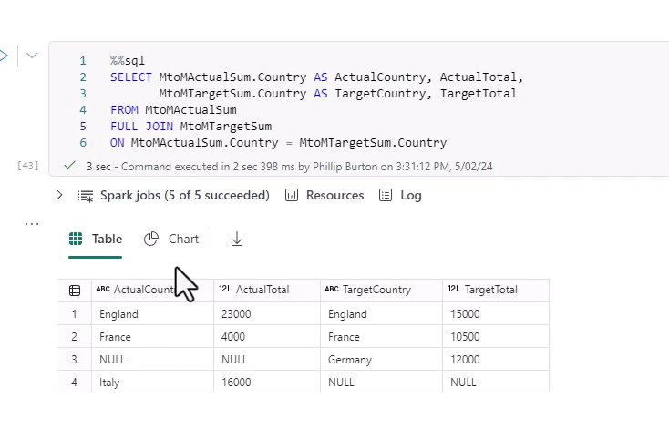
In sql you also need to rename the cols and put in all the columns
Notes:
Use ther table nbames before the country with a dot. And then use aliases.
Don’t use aliases in where clauses and in joins.

Slide 12
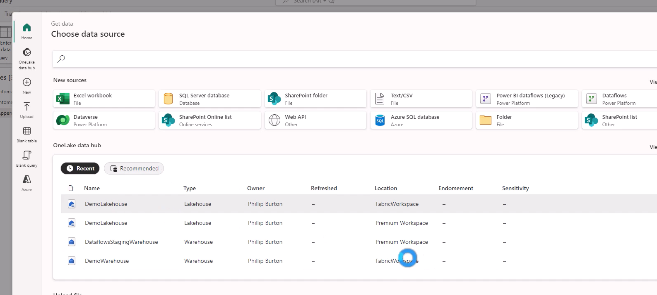
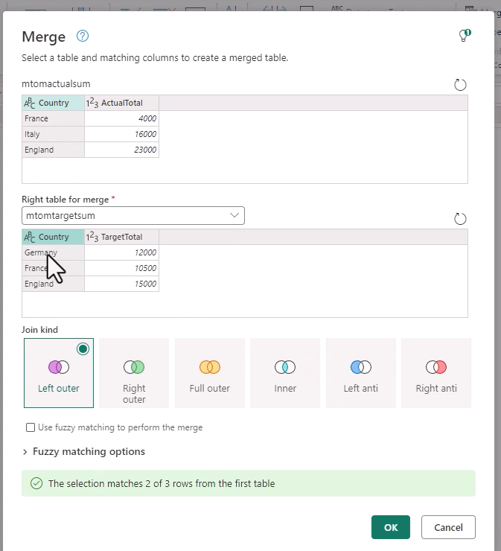
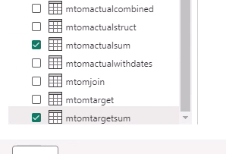
Using df gen 2 for joins
Notes:
Import data from lakehouses
Home Merge as New

Slide 13
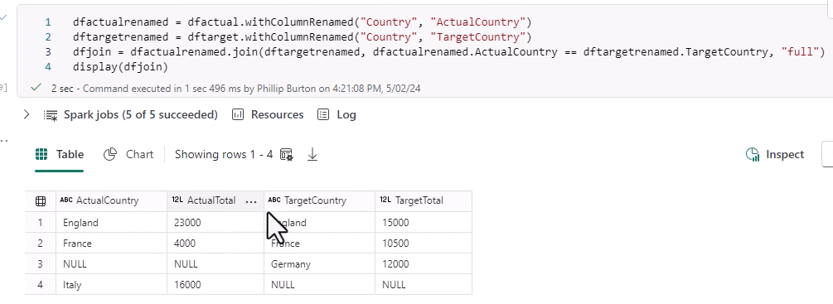
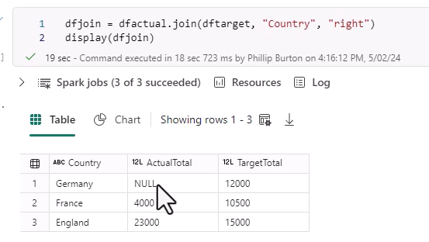
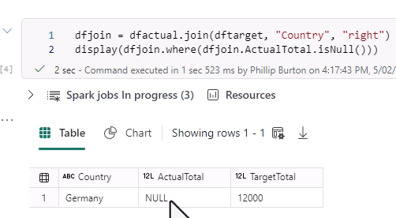
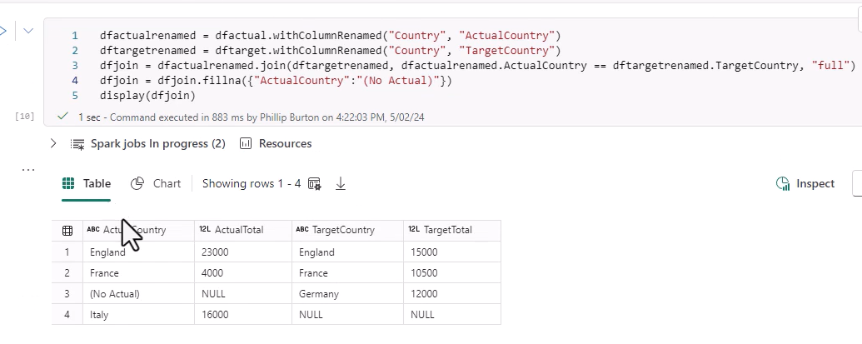
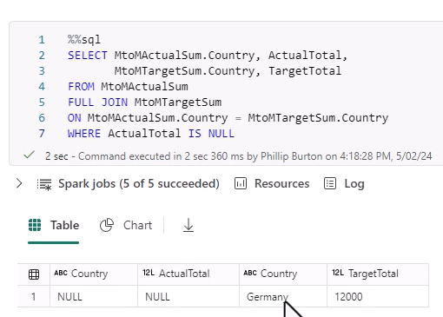
26. Missing Data
Notes:
We use the example table from the right join where we got a null value
Use where isNull to capture the null valie
Can do in sql/
Note on Right we do full joinj and therefore rename the country columns…so we now get 2 cols with different names.
Replacing null with fill na , you name the col in a dictionary , see bottom righyt.

Slide 14
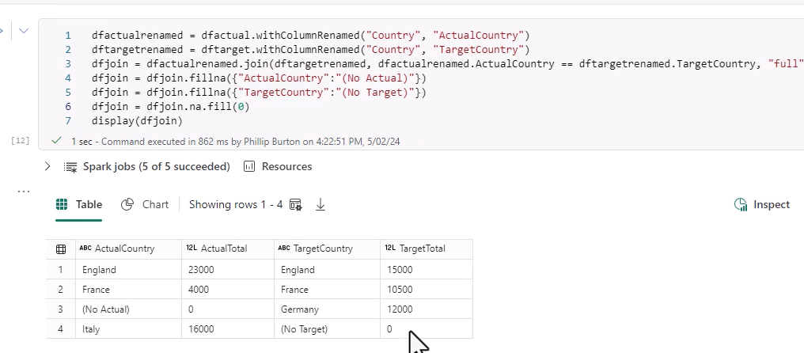
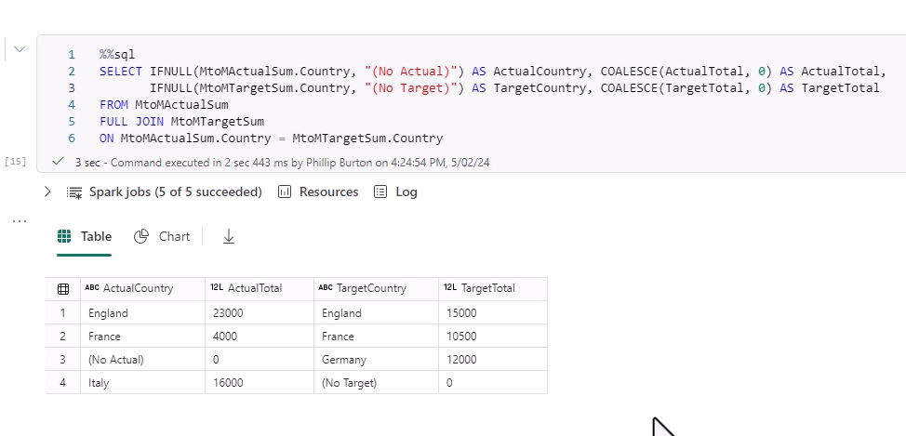
Full scope null replacement ..some with values others with zero.
Notes:
Fillna targets particular cols, na.fill, targets allthe columns.
Can do in SQL as well. See thye COALESCE to fill in blanks with null for remaining columns

Slide 15
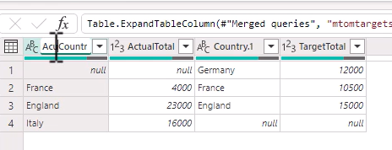
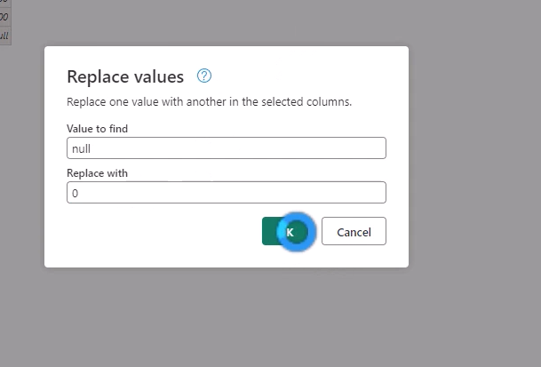
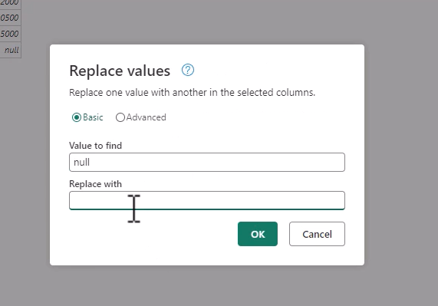
Dataflow Gen2
Notes:
Home Replace values

Slide 16
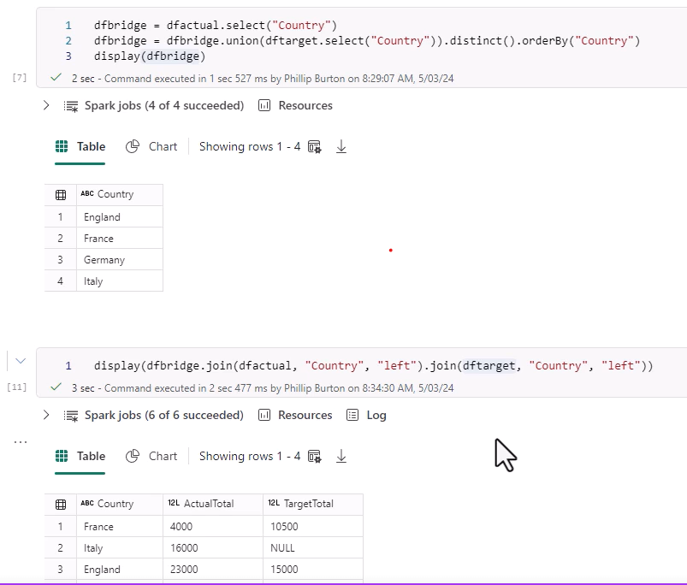
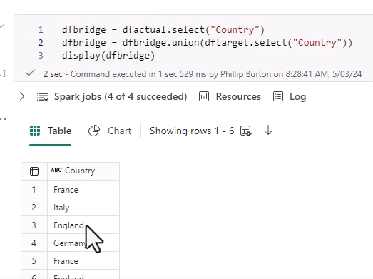
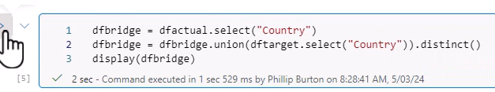
66. Practoice Activity 8 – bridge table
Notes:
Note the duplicates from the initial join.
Remove duplications with distinct
See top right for bridge table impolementation

Slide 17
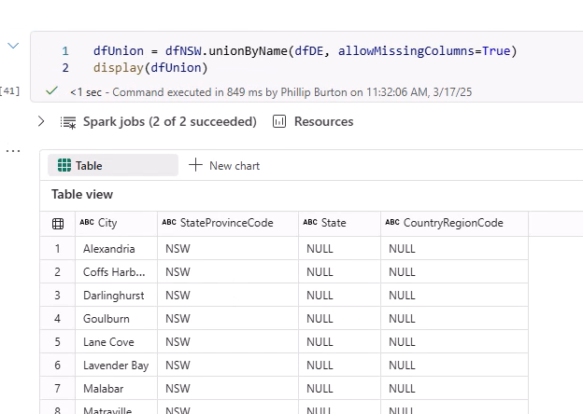



68. Practice activity Spark
Notes:
We get an error in Union
We try use unionByName.. But get adifferent error ..sse above , so on top right we say allowMissingColumns=True , note nulls in missing columns

Slide 18


Result of a Join.

Slide 19

Find duplicates

Slide 21


SQL …Practiceactivity
Notes:
We are union tables with dufferent number of columns and coping in different ways ..
Ie put null there , better to give anallias , else name is NULL
The firstquery givesthecolumnnames

Slide 22

Change to full join

Slide 23

Finding Missiong Data
Notes:
Note

Slide 24

Finding Duplicates
Notes:
1)UseGroup By and Having > 1

Slide 25


15. Schedule Notebooks; Run/schedule In the RUN Menu
Notes:
Notrbook ingest files to tables and transform them..
Youi can schedule note books
Run/ Schedule

Slide 26


Watch notebook..View All Runs
Notes:
Run/View All runs , see scheduled

Slide 27


View resources

Slide 28

Item Snapshots – what it did during the run
Notes:
V ery important for debugging.

Slide 29

NB: Can Schedule from the wspace ..dont have to go into the Notebook
Notes:
Also note ..you can see recent runs.

Slide 30



31. Spark Structured Streaming.
Notes:
Data comes in and auto processed
Loads a shopping file, asks for schema, note the schema.
Note he wants to use the schema, see how he need to import StructType and StructField
And then uses the out put of df,Schema..to configure the schema
Now he readsit in as readStream, and uses the schema brough in when reading the csv.
Note how he uses *.csv…..
He gets error as leaves our StringType..need to import all thes types that are are in StructType
Still gets error “writeStream…” , see above. Cant use display(dfs) ..Must write to a table..
Note , checkpoint location ..allows spark to synchronise with the streaming data..; does not process old data.
If it fails spark can recover from the checkpoint ..therefore you need a location to store it.,

Slide 31


Spark structured streaming continued
Notes:
See how he adds a deltatablepath variable
Then uses it in the query. And places it in a subfolder called ‘_checkpoint’
.start infers that it is a continuous action.
If we have the query like as in the first block..it would run and stop
We need the cell to keep going until query is finished.
We add the function query.awaaitTermination…which is never
The second block with awaitTermination will continue to run.

Slide 32


31. Testing the process
Notes:
Goes to query the shop_table in the lakehouse sql endpoint.
We go back to the lakehouse into files , we load additional file called ShoppingApril…2 files
Goes back toi sql endpoint ..and runs the same query as before
Previously 12,, Requires a bit of refreshing and now 14 Rows.
Uploads May and Junew files , goes to SQL analytics endpoint ..requeries it. Refresh queries ..18 rows..
Note the wild card ..so names not exactly the same.

Slide 33


74. Spark Job definition.
Notes:
Do we have to have this code in a notebook for this to run.
Take the code and run independent from Notebook.
We copy and paste to Notepad.
And save it pysparkcode.py.. A python file,
Goes back to the lakehouse and deletes all of the additional files and deletes the table..

Slide 34




Go back to wspace , new item , Spark Job def.
Notes:
We now upload the .py local file
Can also add reference files etxc
Need a lakehouse reference , select shopping lakrehouse
Save the Job definition…Run, Refresh and see the Job start and run,,,
It failed ..Read the message ..”Spark JVM……See on left bottom!
Read the code..we have spark.readStream…. But spark is implicit in the Noptebook.
In a Sparkj Job we mustr explicitly define it .
See 2 additional lines in the code…
Ie import the spark session , and the define what spark means..see bottom left of screen .. The first and third line…
Del;ete existring file and upload again.
Open and run again, see the runs and see the definition running.,
Go back to lake house and see the shop_table table
Go back to endpoint and select the table, but error , so refresh the table,
I
M

Slide 35

See the table rowss
This lecture used a Spark Streaming job definitioin to continuously run a program to read in new files and add to existing table..append . The job definition is continupously running.
Notes:
Close lake house and close the job definition… , so we only have the endpoint.
He goes to onelake explorer ,, and copies in more files.. Into the onelake folder.
He runs the query in the SQL endpoint…after few minutes u now have 18 lines.
You now have added lines
Go to Job Def , must provide a py file..

Slide 36

Py file must have Spark definition defines
Notes:
1) Secify the lkakehouse and see messages and runs to see the executioin!

Slide 37

Notes:
Go through all the menus tp see details of the Runs.

Slide 38

75. Choose between Pipeline and Notebook.
Notes:
Datsaflow vs notebook for inmgestion.
1)

Slide 39




76.Parameters in Notebooks.
Notes:
Opens New Notebook. With a lakehouse.
He has an existing Table mtoM actual
Now he wants an extract for England. Leaves a cell open above theis one
Does a test to filter for England m saves England Dtaframe
Tests a query on the England table in the SQL endpoint
We now wanr a Country we specify , by creating a parameter…goesd in first cell. N We just put in thre variable , and populate with England and get same result

Slide 40


We want parameter to be set outside notebook ..
Notes:
Set the parameter buy going to … on RHS top of blank cell , toggle parameter cell.
See word parameters , and can still run cell. / notebook. Nothing has changed

Slide 41




We now create a new pipeline in wspace
Notes:
In this pipelkine we create a notebook activity
We now select our notebook parameters ,as our notebook
We need to assign a value to Parameter_Country in Notebook , so go the base parameters in main pipeline settings
Base parameters , new name and value , must be same name as notebook., Type ..ie String or Int , Value Franse
Save it and Run ..Pipeline .. Suvccedss
Go to SQL Analytics endpoint and see the query of the table to see Franse ..???
To change it again go the the Notebook Itenm in pipeline , clicj on it and change the value of the parameter. And Rumn wirg Italy , query gain in Endpoint

Slide 42





77. Dynamic Expressions in Notebooks.
Notes:
We want the user to change the parameter in a run and not have it fixed prior to Run.
We use dynamic expressions, Clixck on add dynamic content , and seed side screen… We add a pipeline parameter , Click + sign, while in paqrameter menue on the right, , Put in parameter details , this parameter is over and above the current one in the pipelinre …
Now click country parameter , that you have as a listed choice
Notice the expressin builder @pipeline.parameters…Notice the xpression builder expression in the Value box

Slide 43


Save and run the pipeline
Notes:
Pipeline asks for Input into param,eter as it runs , England in the default in thed notebook.
Change tpo Fransse and click. Run
Go to SQL Endpoint to Query The table , But we still have Italy..the old parameter value,
Note you are populations the Parameter in the notebook with the Dynamic parameter of the expression builder

Slide 44


There are other variables and menus in the expression builder
Notes:
Also Triggeer Paramertres

Slide 45


Varibles and functions
Notes:
Large function language available , See example date functions

Slide 46



79. Practice activity 10.
Notes:
We first set up parameter Notebook , where the parameter is initialized and used ie Lnmae =Lopez , check in endpoint , Refresh!!!
Notyebook working with Parameter we can close it!
We create a pipeline – add notebook..settings ,,,
Attach the notebook to the Notebook Activity , andgo to base parameters, next page

Slide 47


Notes:
1) Note , name of this parameter needs to be name of the parameter in the Notebook , see the Tpe, see value Hernanadez , Run Pipelibe , go to Endpoint ..and check

Slide 48





Notes:
Now addd Dynamixc Content , and add a dynamic expression parameter that you are going to use to populate the Parameter with , don’t call it the same as the base parameter !!!..
Ie Family Name , default name of Sanchez, Save it and REMEMBER TO CHOOSE THE PARAMETER in the List .. We created it as maybe one of many to choose from , so make sure to choose it so it apoperas in the Dynamic Expression above and then in the value fiels in the Base parameter
Note the expression in the value of the the base parameter
Run and override default with Perez
Go to SQLK endpoint and run query , refresh and see Perez

Slide 49
S11 CREATING OBJECTS

Slide 50





80. Create and Manage Shortcuts
Notes:
Shortcuts point to the data
He creates a table in the WH… called tblBridhge
Now create a shortcut to that table from LH…
Go to Tables … New Shortcut.. We use One Lake , look at the top headings to get a sense of a short path to find your data.
Can also Filter by Type of Source
Go to Exploreerr , and Click the Worlspace to filter , DW, and go find that table. , check the table and Next / Create
Notice the Two headed arrow Icon.
The user must have read permissions for target location.
Use the shortcut like any othedr table…
You now use it in Notebook , like any other tablre. Ie load ir etc,. Ie load to Spark.
What happened when u delete shotrtcut , would target be affected? No.
What happens if you delete or rename table in WH? Thre shortcut can break ..it wonyt automatically track it .
You can create shortcuts in table and files folders ..Dont use spaces in the Filenames ..Shrtcut wont recognize them!

Slide 51

81 Workspace Settings …
One Lake Settings – On / off Cache , only for Exyternal Storage GCS (Google Cloud/ Shortcuts/S3 Shortcuts )
Notes:
When it reads these files they are stored in a Cache.,
If cloud source updated , then it reads from source and cache updated, cached maintained for at least 1 day and can be uopdated.
Thedre are many tenant settings , many oned lake settings in the tenant
See tenant settings for one lake
Allows uses to use the One Lake explorer App.

Slide 52


82. Create Azure SQL Database as a Source
Notes:
Go to Azure SQL Database in Portal.
Create new resource group.
Datsabase Name and Server , Microsoft Authentication…/ set Admin / LR backup Storgae / Addd sampole DB /Public End Point and Create
Go top Resource ..and its there.

Slide 53

SQL Database

Slide 54


44. Imolement File Partitioning - for analytics workload , using a pipelined.
Notes:
In Azure we go to the query editor in the database and selkect the table.
Thisapplication would be for big files.
We now divide the table up, sensibly ..(Year or Month or Regions..)
Wew have a look at the count of lines by state ..would this be a suitable partitioning strategy? Each partion can be processed separately.
How do we do this.. Data Piperlines

Slide 55



File Partioning .. Continmued
Notes:
New Pipleline / Copy Data Activity …
Source is Azure SQL Database..
Must get connection settings … Go to azure , tio the database and gedt the server Name , and the databnase name SQLServerDatabase
Organizational Accvount , sign in

Slide 56




Fill in all the source details , in the CopyData
Notes:
Feed in the destination Settings as shown ..see advanced settings as well. Bottom right ,
You can do multiple Partitions ..

Slide 57



Validate and run
Notes:
1) Refresh a couple of times to see the table
2) Right click on Address table ..View Files … you can now see the partitioned files and it shows how they were partitioned.
3) By Country , and then click on Country , and see States , and finally the Parquet Files.

Slide 58



Partitioning Continued..Open Up a Notebook
Notes:
can we use address Data tabler ( tye partityioned table ) just like any other table, as per noterbook read in ..
We use the normal read , as if default .. And we get the result,
We can read as Parquet files as well .. Same as before …
But now wee can drill down .. To the individual files
But note we don’t have country region , that’s part of the Folder name.

Slide 59

Can go to the lowest level of aggregations at the state level …

Slide 60


Reminder the destination advanced: settings
Notes:
Note where the Parquet is stored.

Slide 61

44. Implementing Partitioning Using Spark..in a lakehouse
Notes:
Previoiusly we impolemented Partioning from a Warehouse into a Lakehouse.
Now we implement where source is a lakehouse and do it via Spark.
We now add the partition By clause , in the saveAsTable clause … in order to create the partions in the lake house
We partition by many Categories , here Color and Product Subcategory
We can also just use save , must specify the location , ie Tables .. Which is different .. Between the 2 instructions.

Slide 62



Partition oin Lake house continues ..
Notes:
Refresh in the lakehouse ; click on … and View Files
See all the separation of the files

Slide 63


Press into color and see the next level , Subcat and then into that and see the actual file
Notes:
1) Veryt Simple , use a PartionBy

Slide 64
85. Implemenmt Mirroring of External DBs
Foillow the video ,
Notes:
Toi create mirriored Db
New Item , Mirror , and can see various mirroered databases.
New sources , Azure SQL databases , we have to fill in all the connection settings , so we go back to the SQL DB etf

Slide 65


87. Practice 12. Solution.
Notes:
Note tyeway to Partition the Table..

Slide 66



Go to PartionedTable in Lakehouse to View Files
Notes:
Right Click to View Properties
See the urls of full and Re;lative paths
C0opy thye Relative path , go back to the note book
The because ther files arer partitioned we can just load frpom that partition from the path

Slide 67


Loading from the Relative path a partition of the table
Notes:
Note its read. Parquet as it’s a file partition not a table
We hasd 655 in entire df , now 48 rows ANDNO COLUMN FOR COUNTRYT REGION CODE !!!
It would be constant over the entire table, and the column name is in the folder or path name

Slide 68
S12 Optimize Performance in Notebooks

Slide 69


88. Identify and Resolve performance bottlenecks in Notebooks
Notes:
1)We have datra stored iun partitions, by Country_Region , and then by state.
2) If I was interested in 1 State it would improve performance .
3) If I run a new notebook it takes a while to start the pools.
4) To speed things up have high concurrency settings so that each notebook not need its own sessioin.
5) High concurrency sessions are run by same user , and have same default lakehouse
6) Have the same spark compute configs / same library packages
7) Standard session , dedicated compute for 1 notebook.

Slide 70



High Concurrency session
Notes:
Now opens another rnotebook .., you connect that notebook to the high concurrency sessions we just set up.
See if high concurrency is set upo in your workspace settings .. Data science ..high concurrency …
Need to see if that’s on.

Slide 71


88. Performance improvements with V order.
Notes:
1) V order enables fast read in Spark and SQL.
2) Applies sorting and compressioin
3) Why not apply it all over… decreases write speed ,
4) How to check V order Enablement!.
5) See above how to enable in SQL and Spark.
6) The above was getting , to set it see above

Slide 72

Can set it per table

Slide 73


We can optimize write
Notes:
First test if is enabled
Setr it ..true

